Slide 1
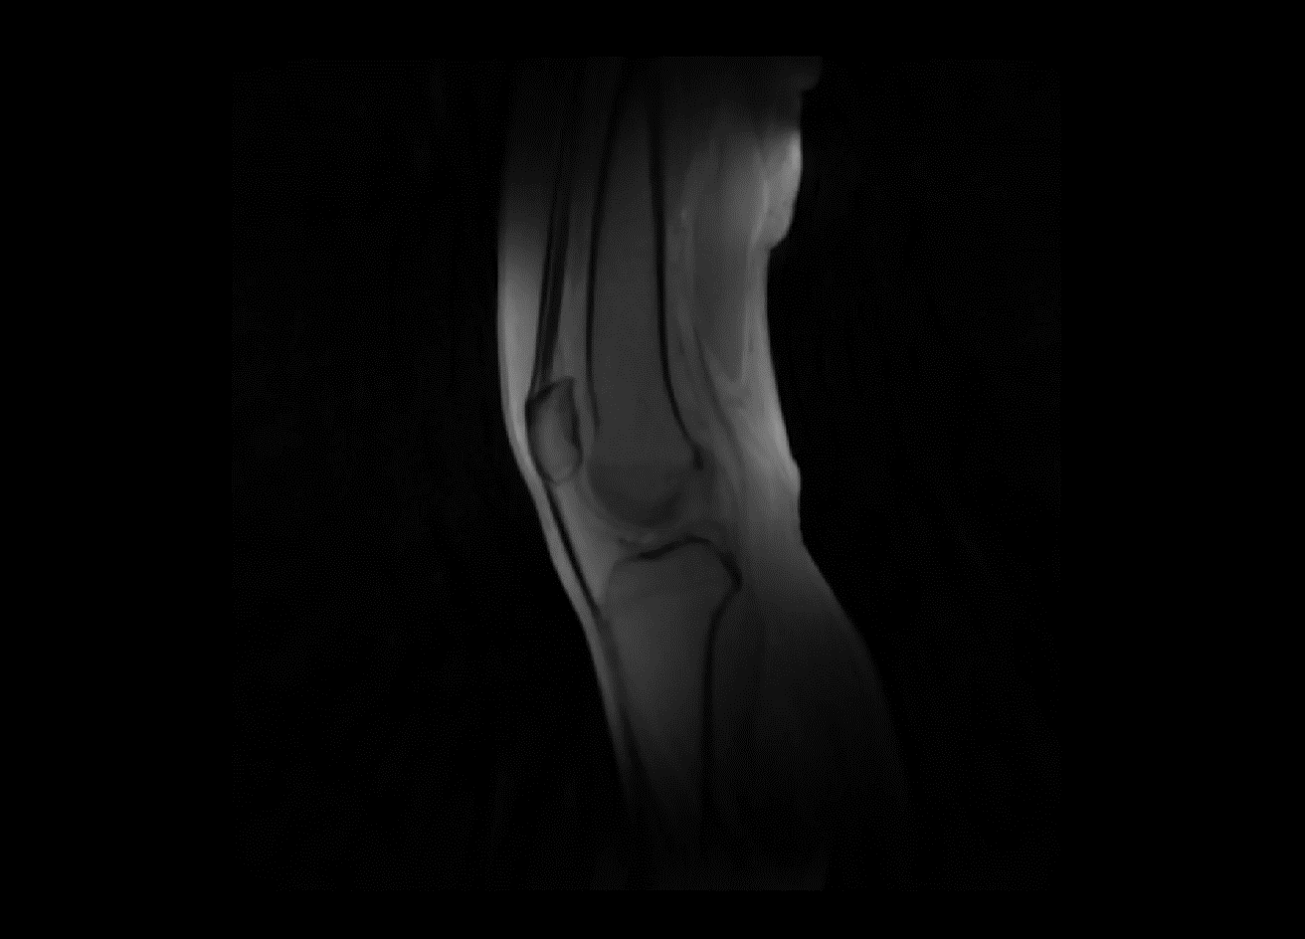
The data:

Slide 2
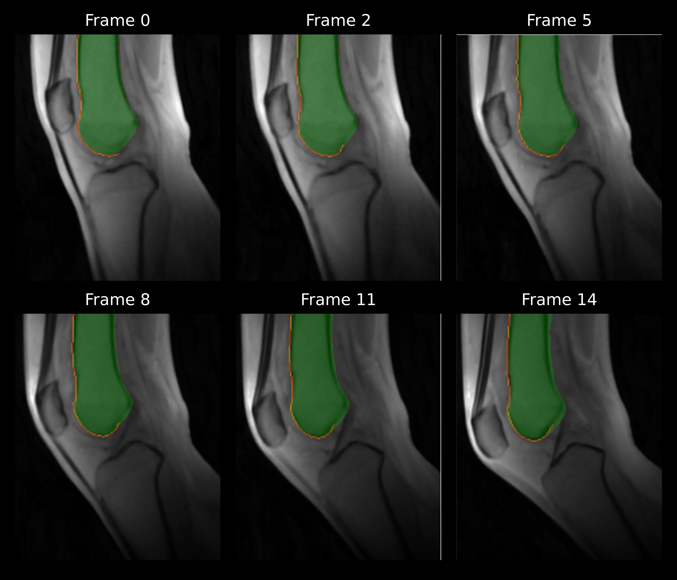
Femur segmentation

Slide 3
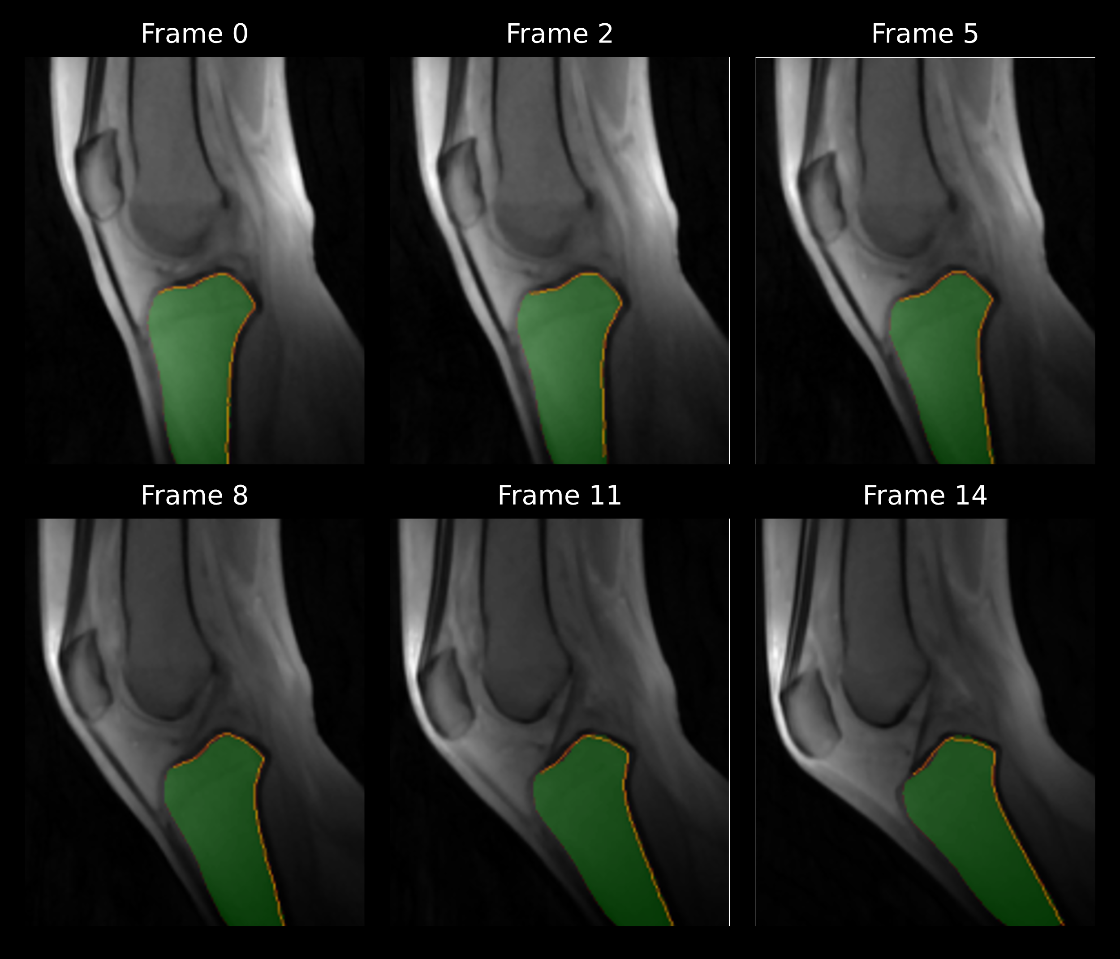
Tibia segmented

Slide 4
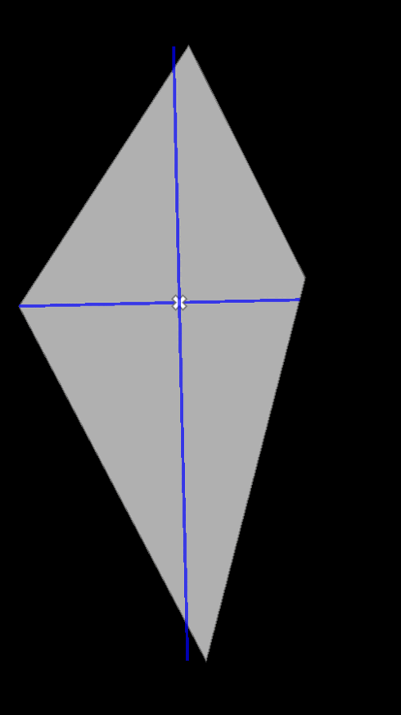
Using PCA

Slide 5
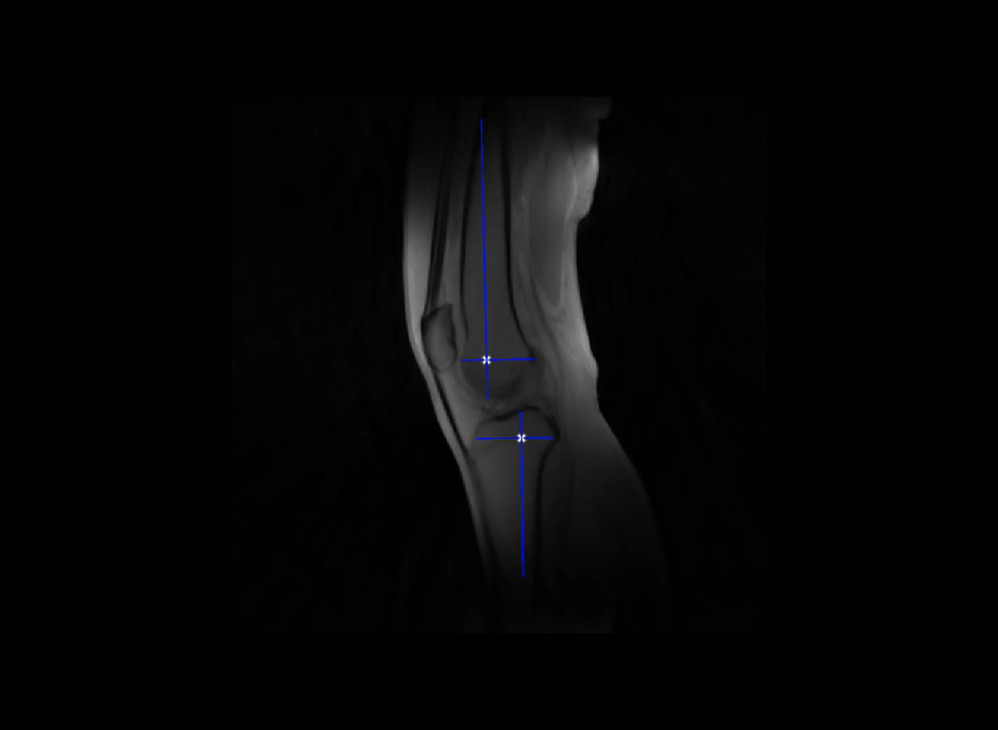
Title

Slide 6
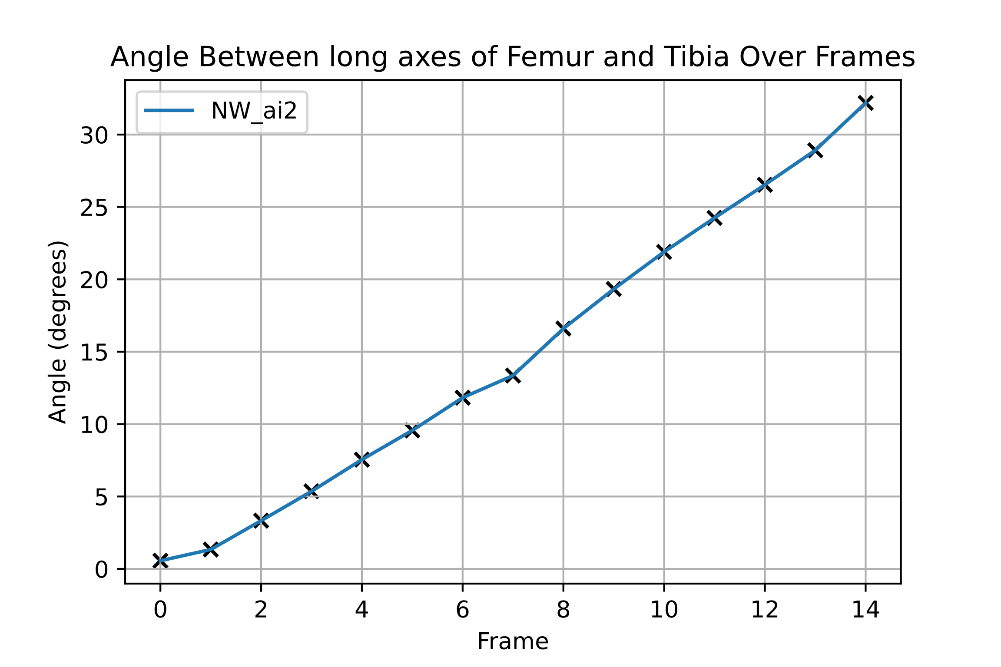
Angle between primary axes of femur and tibia

Slide 7
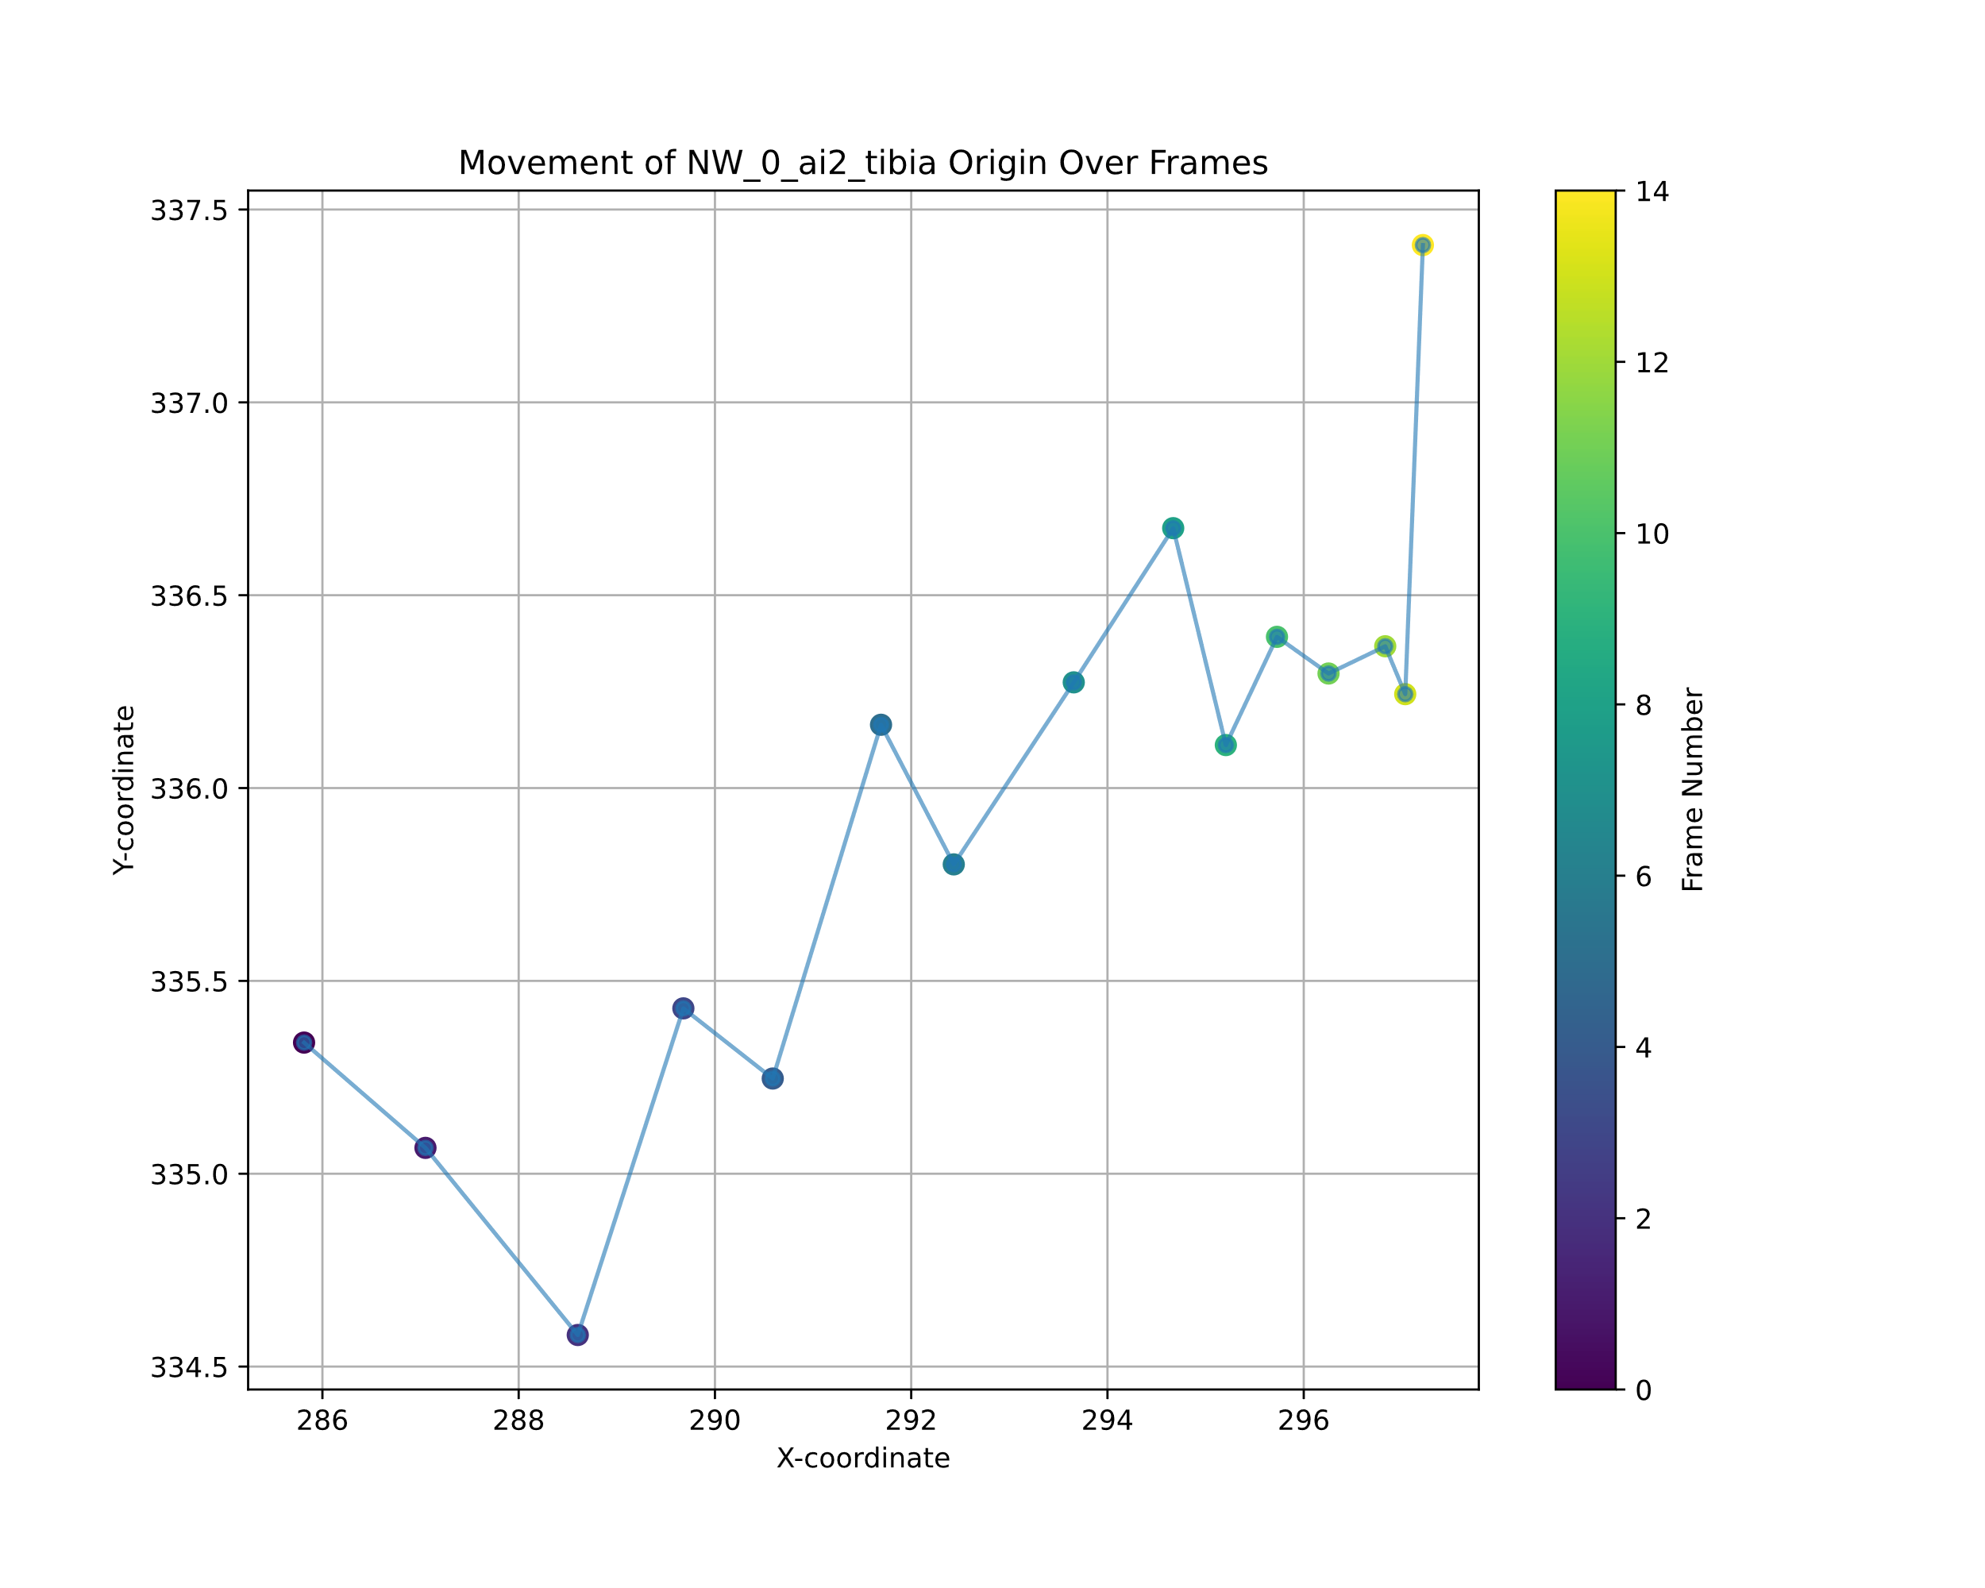
Tracking the tibial origin across frames

Slide 8
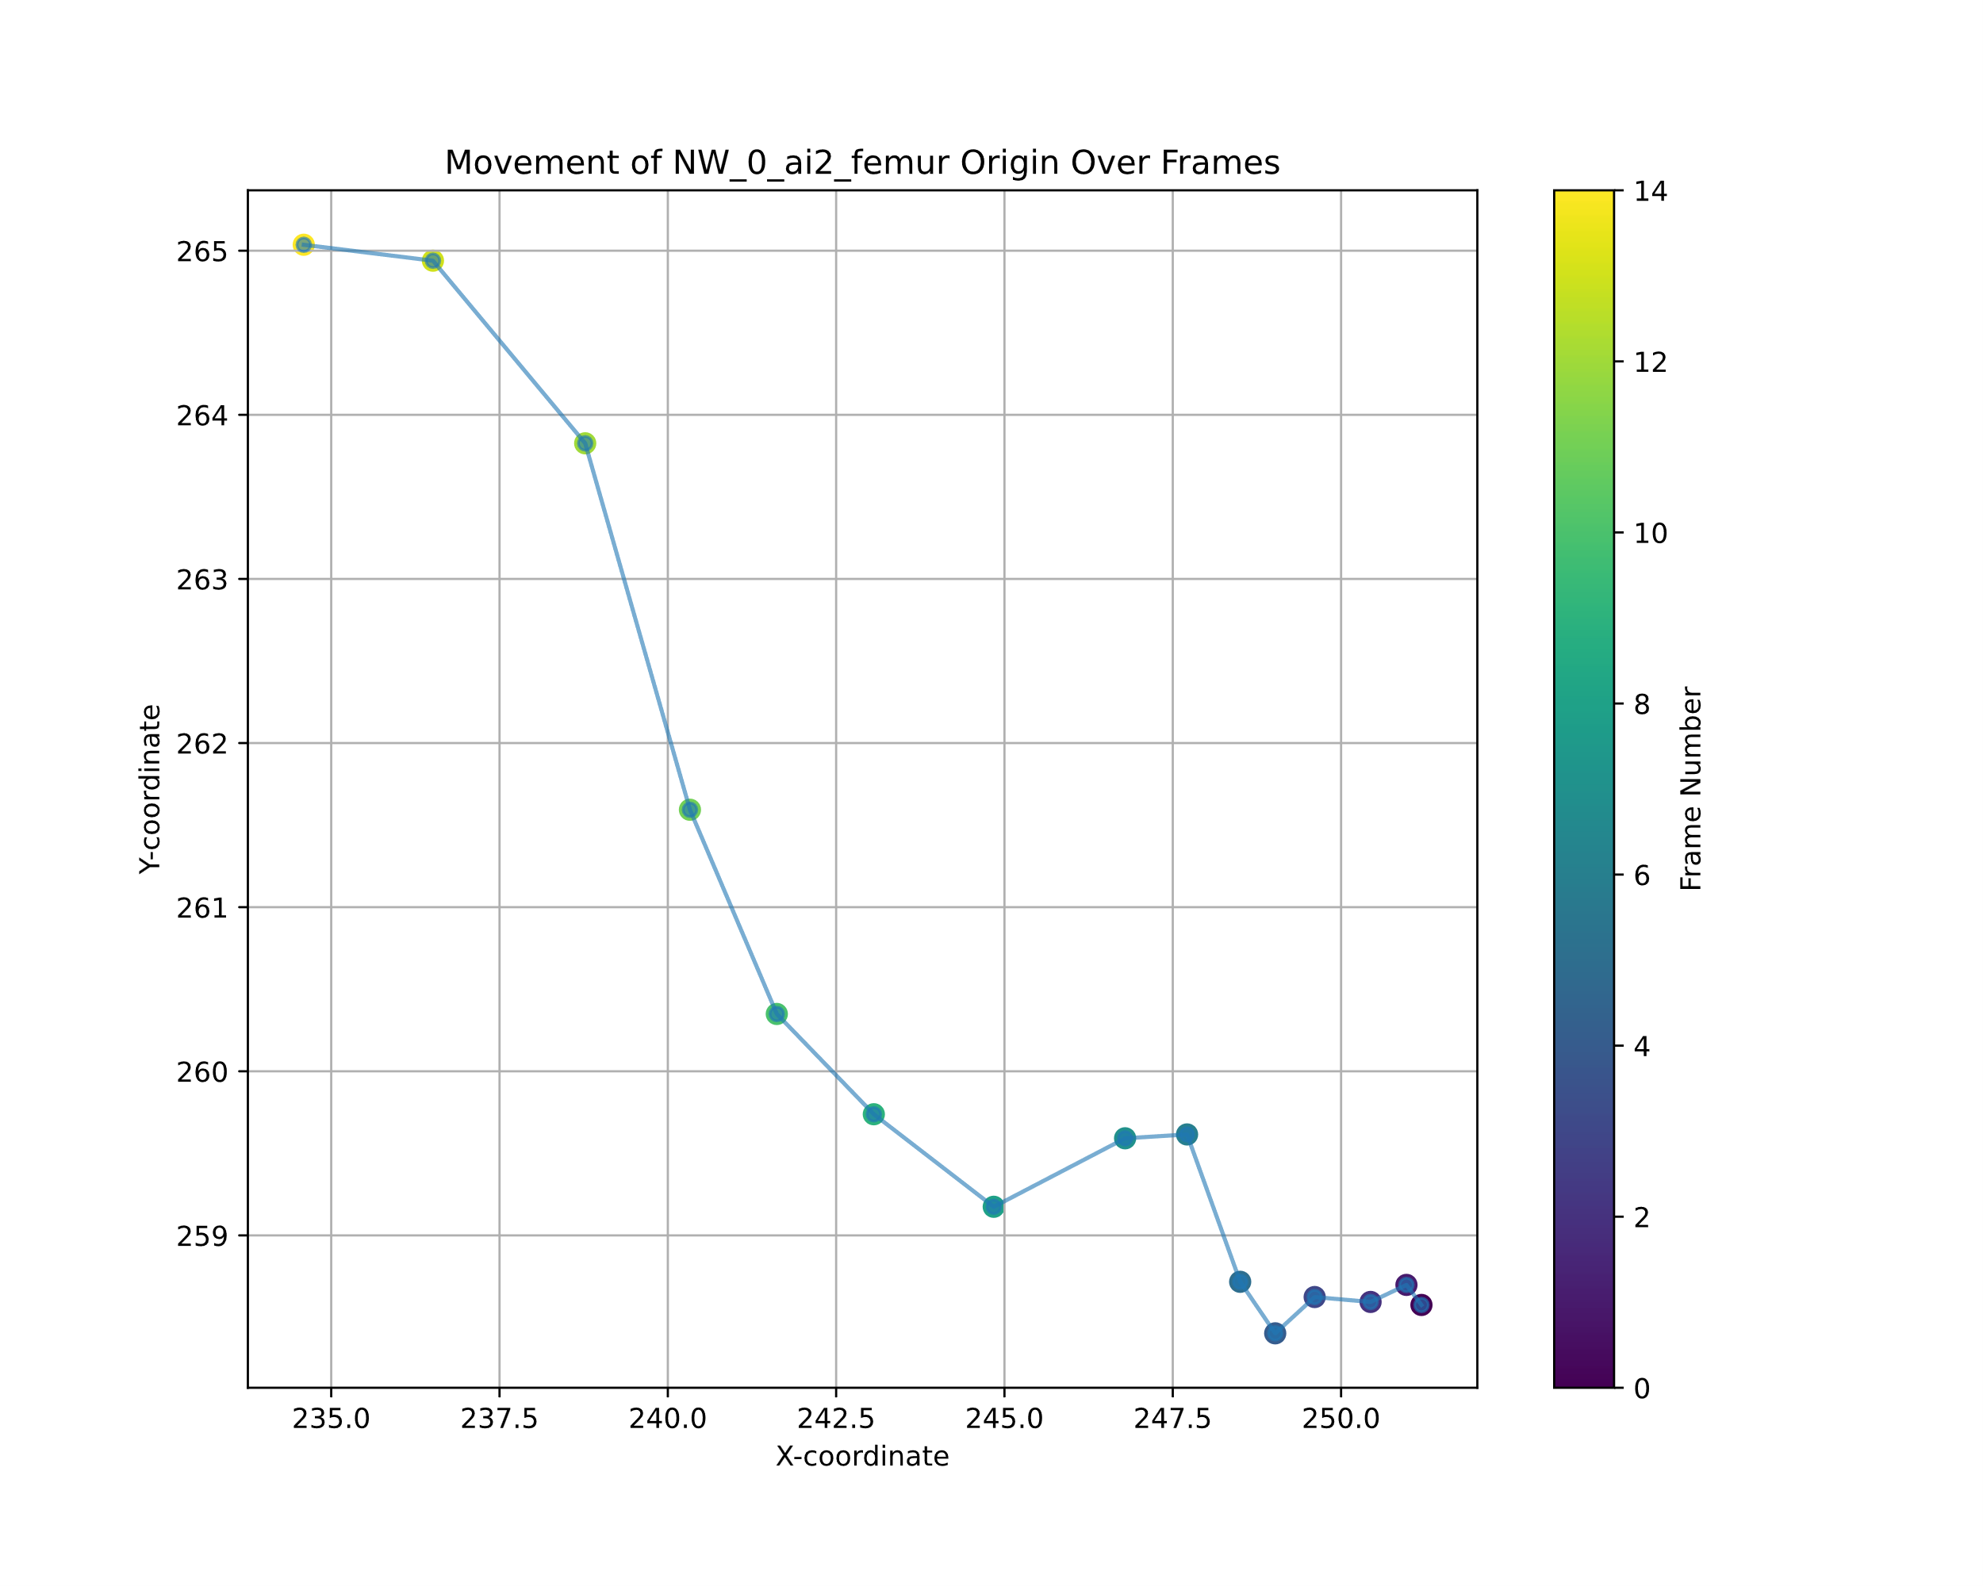
Tracking the femoral origin across frames

Slide 9
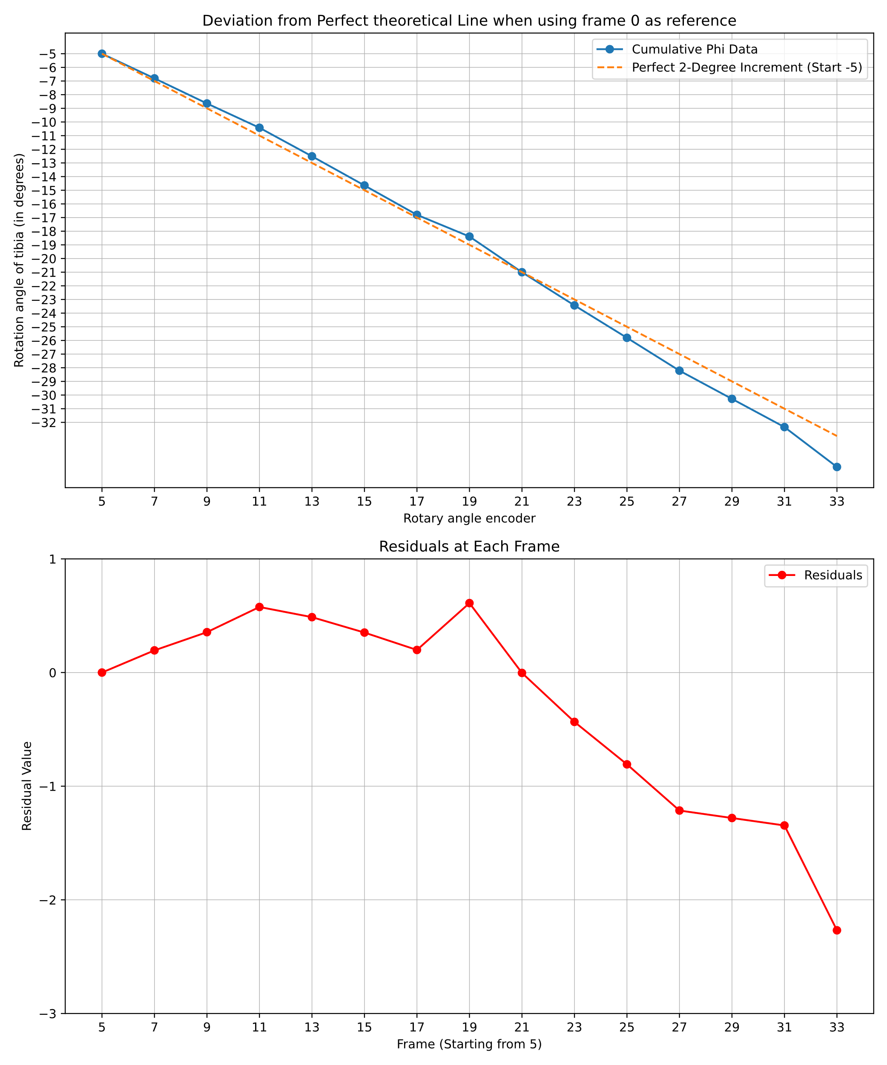
Rotation matrix:
[ x y ɸ ]
First frame as reference:
Offset: 5 degrees

Slide 10
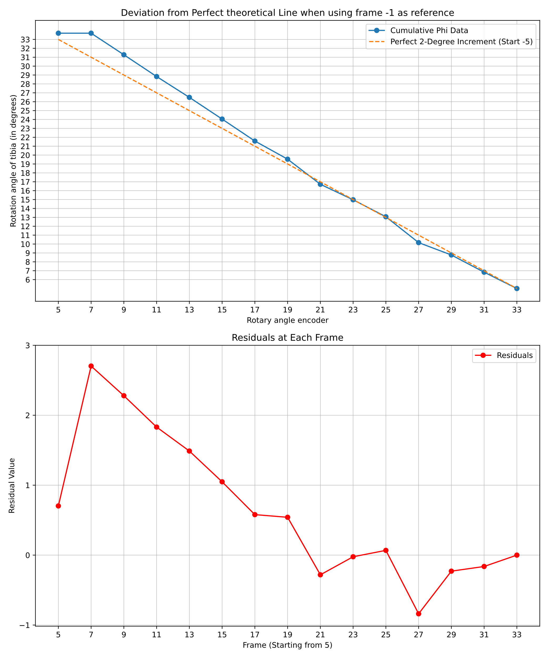
Last frame as reference:

